Slide 1


Andi
15.07.2025

Slide 2

Outline
Executive Summary
Introduction
Methodology
Results
Conclusion
Appendix

Slide 3
Executive Summary
Summary of methodologies
In this application where several methodologies used. At first der was a data collection via api. This was followed by webscraping and data wrangling. After that there was a sql section and at last there were several models be trained and tested.
Summary of all results
The project was a huge success. Every task could be performed and every test was passed.

Slide 4
Introduction
Project background and context
The project is about SpaceX Falcon 9 launches. For this project there are several open available data that can be used.
Problems you want to find answers
The main question is to determine to calculate the cost on the factor if the first stage will land or not. And to train a model for it.

Slide 5

Section 1

Slide 6
Methodology
Executive Summary
Data collection methodology:
Data was collected via API calls and WebScraping from Wikipedia.
Perform data wrangling
The Data was processed via a DataFrame
Perform exploratory data analysis (EDA) using visualization and SQL
Perform interactive visual analytics using Folium and Plotly Dash
Perform predictive analysis using classification models
The used models were: SVM, Classification Trees and Logistic Regression

Slide 7
Data Collection
Describe how data sets were collected.
The data were collected via API calls from spacex and via WebScraping from Wikipedia.

Slide 8
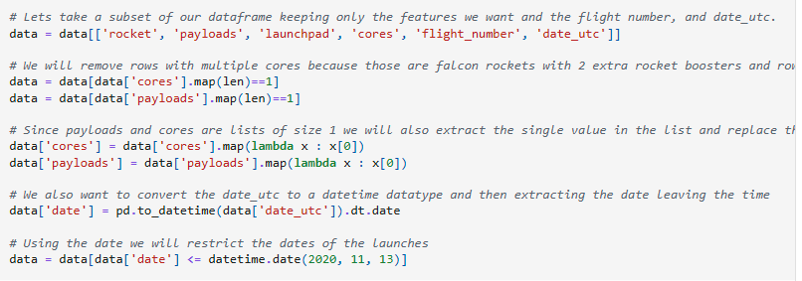
Data Collection – SpaceX API
Repository: https://github.com/bon87-cmd/ibm_capstone_gradedassignment/blob/1257bb8163807db0b155a84ffc788ed29543bc24/01_jupyter-labs-spacex-data-collection-api(1).ipynbPresent your data collection with SpaceX REST calls using key phrases and flowcharts
Example:

Slide 9
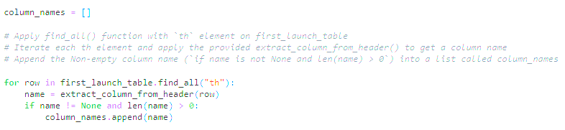
Data Collection - Scraping
Repository: https://github.com/bon87-cmd/ibm_capstone_gradedassignment/blob/1257bb8163807db0b155a84ffc788ed29543bc24/02_jupyter-labs-webscraping.ipynb
Example:

Slide 10
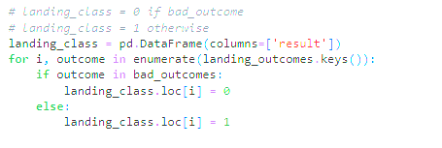
Data Wrangling
The data was processed via Pandas DataFrames.
Repository: https://github.com/bon87-cmd/ibm_capstone_gradedassignment/blob/1257bb8163807db0b155a84ffc788ed29543bc24/03_labs-jupyter-spacex-Data%20wrangling.ipynb
Example:

Slide 11
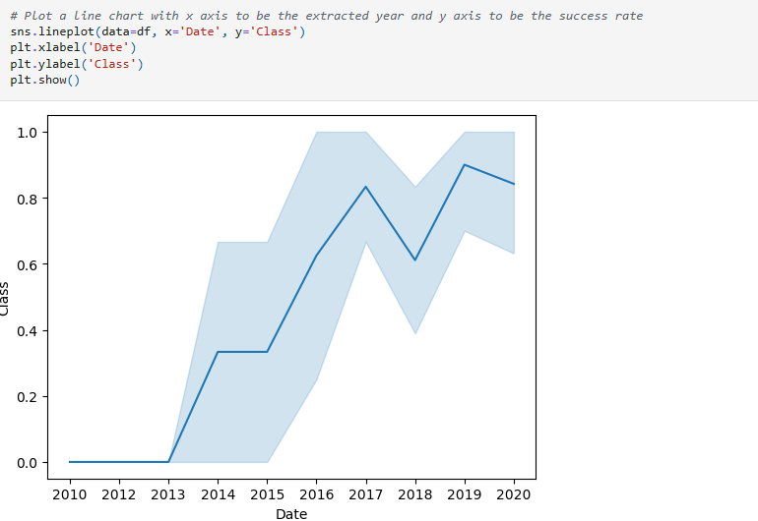
EDA with Data Visualization
Different charts were plotted like Scatterplots, Barplots and Lineplots
Repository: https://github.com/bon87-cmd/ibm_capstone_gradedassignment/blob/1257bb8163807db0b155a84ffc788ed29543bc24/11_edadataviz.ipynb
Example:

Slide 12
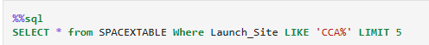
EDA with SQL
There were several different sql techniques be used for doing the tests like subqueries and calculations
Repository: https://github.com/bon87-cmd/ibm_capstone_gradedassignment/blob/1257bb8163807db0b155a84ffc788ed29543bc24/10_jupyter-labs-eda-sql-coursera_sqllite.ipynb
Example

Slide 13
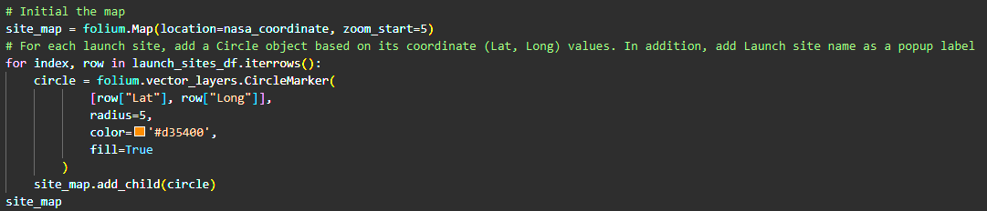
Build an Interactive Map with Folium
There were Circles and markers be used to draw different locations on an USA map
Repository: https://github.com/bon87-cmd/ibm_capstone_gradedassignment/blob/1257bb8163807db0b155a84ffc788ed29543bc24/20_lab_jupyter_launch_site_location.ipynb
Example:

Slide 14
Build a Dashboard with Plotly Dash
There were used different functions of plotly
Repository: https://github.com/bon87-cmd/ibm_capstone_gradedassignment/blob/1257bb8163807db0b155a84ffc788ed29543bc24/20_DV0101EN-Exercise-Generating-Maps-in-Python.ipynb

Slide 15
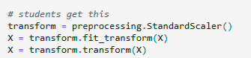
Predictive Analysis (Classification)
There were used the different models SVM, Classification Trees and Logistic Regression to train the model
Repository: https://github.com/bon87-cmd/ibm_capstone_gradedassignment/blob/1257bb8163807db0b155a84ffc788ed29543bc24/30_SpaceX_Machine%20Learning%20Prediction_Part_5.ipynb
Example:

Slide 16
Results
Exploratory data analysis results
Interactive analytics demo in screenshots
Predictive analysis results

Slide 17

Section 2

Slide 18
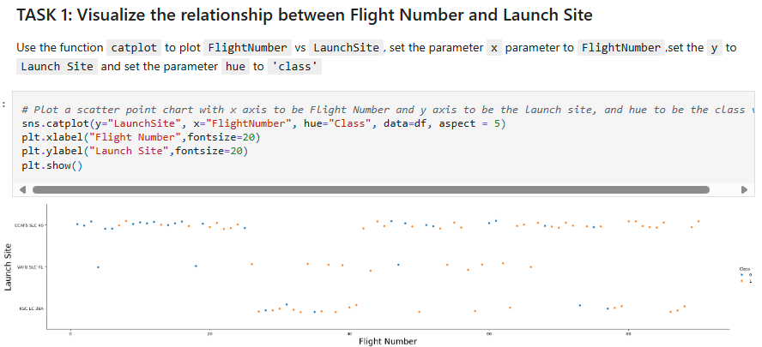
Flight Number vs. Launch Site

Slide 19
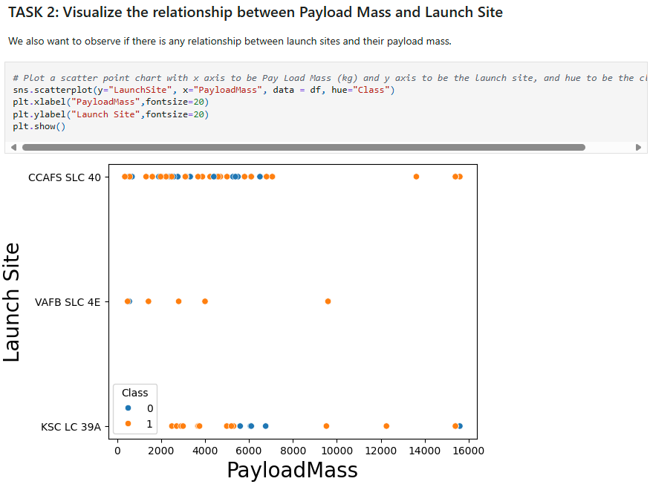
Payload vs. Launch Site

Slide 20
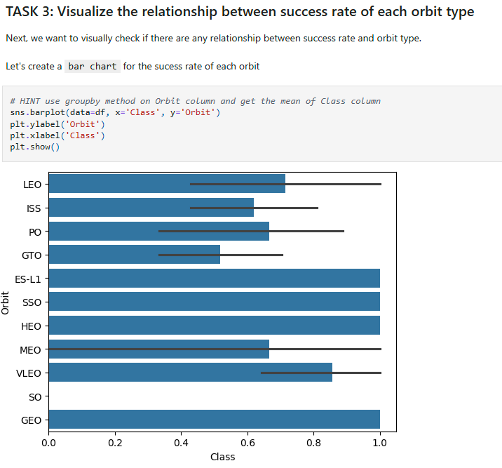
Success Rate vs. Orbit Type

Slide 21
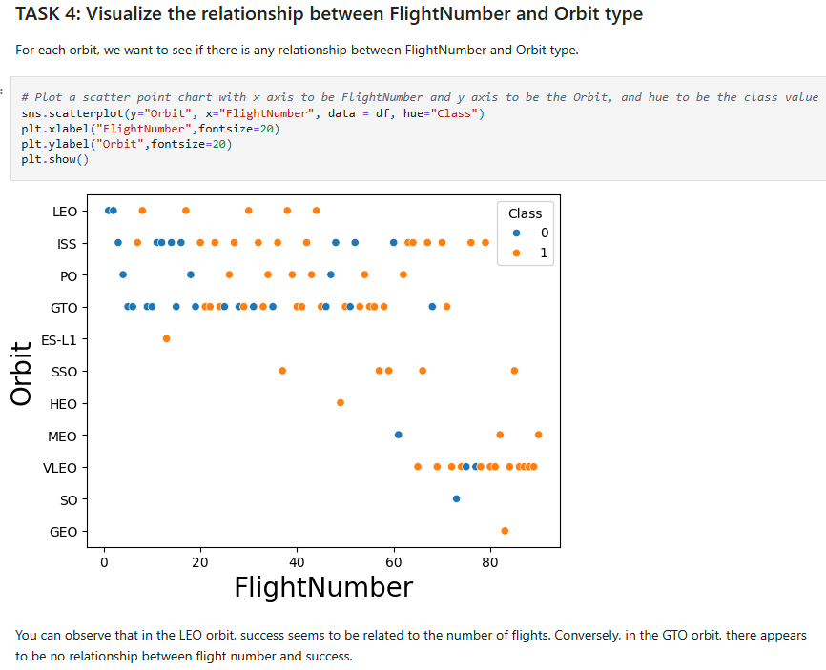
Flight Number vs. Orbit Type

Slide 22
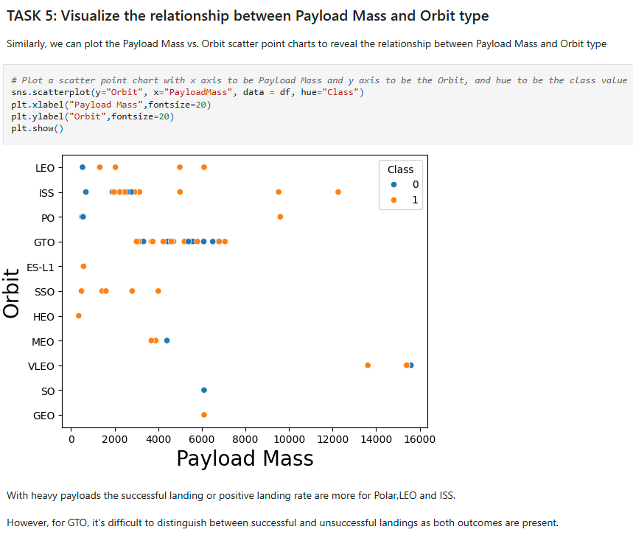
Payload vs. Orbit Type

Slide 23
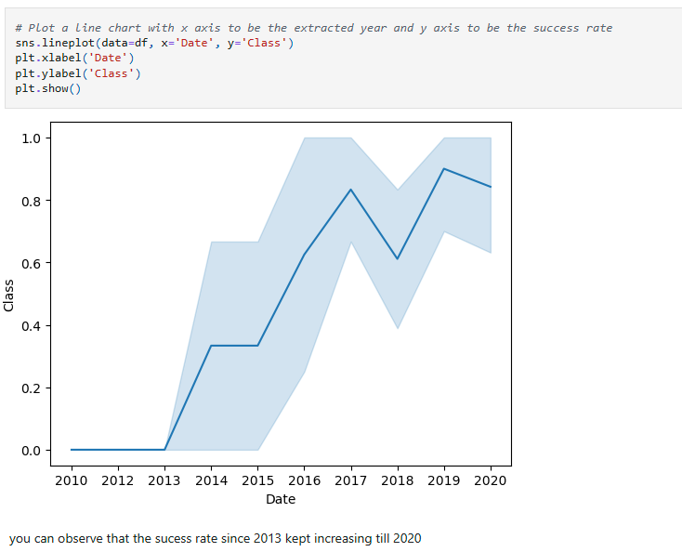
Launch Success Yearly Trend

Slide 24
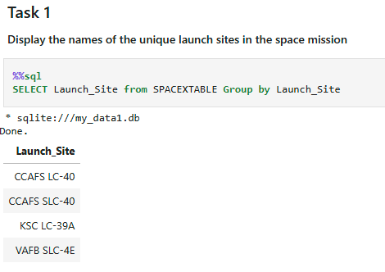
All Launch Site Names

Slide 25
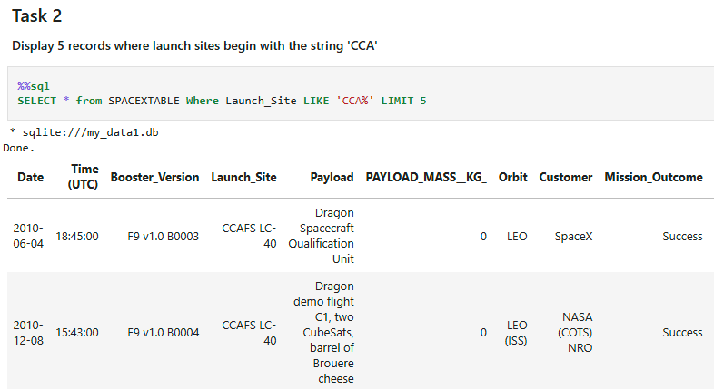
Launch Site Names Begin with 'CCA'

Slide 26
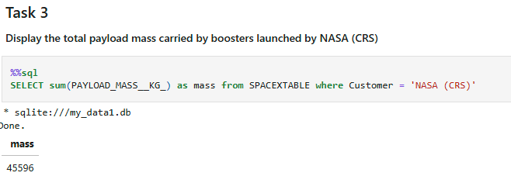
Total Payload Mass

Slide 27
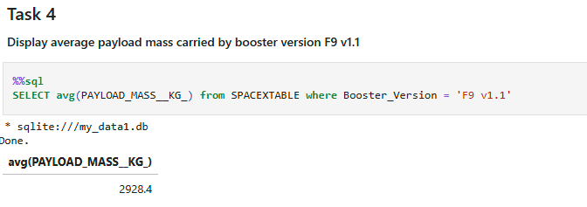
Average Payload Mass by F9 v1.1

Slide 28
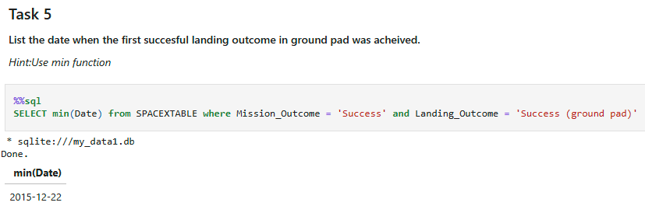
First Successful Ground Landing Date

Slide 29
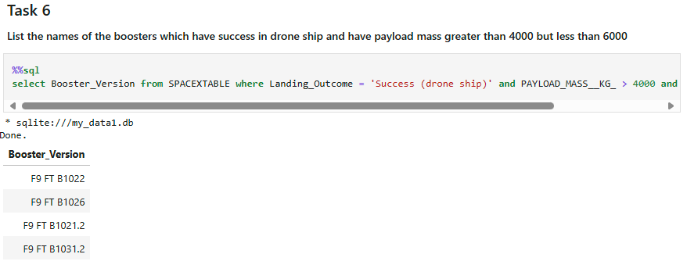
Successful Drone Ship Landing with Payload between 4000 and 6000

Slide 30
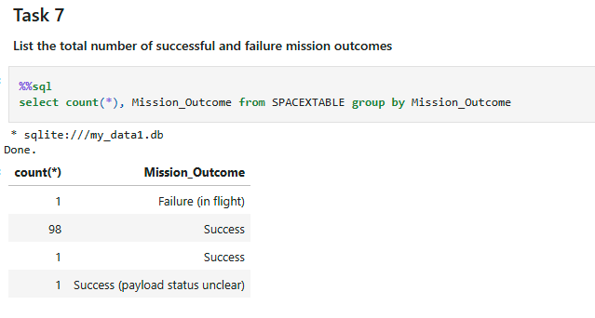
Total Number of Successful and Failure Mission Outcomes

Slide 31
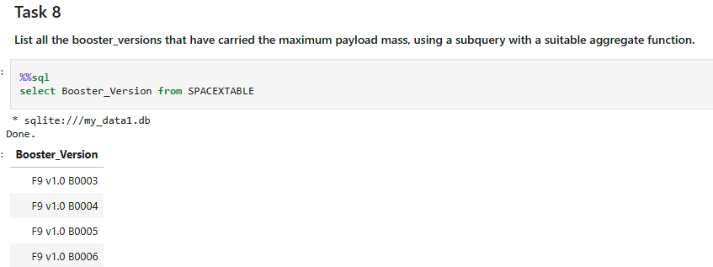
Boosters Carried Maximum Payload

Slide 32
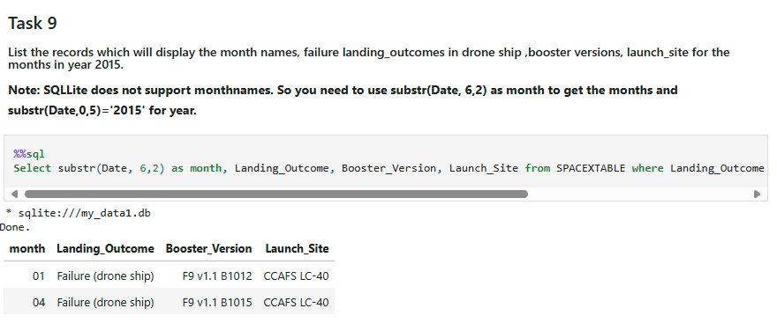
2015 Launch Records

Slide 33
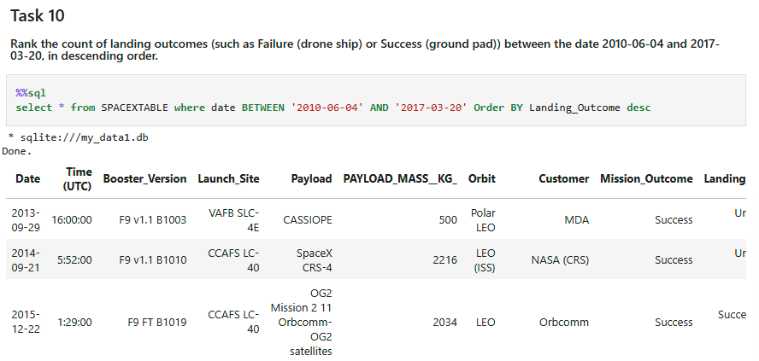
Rank Landing Outcomes Between 2010-06-04 and 2017-03-20

Slide 34

Section 3

Slide 35
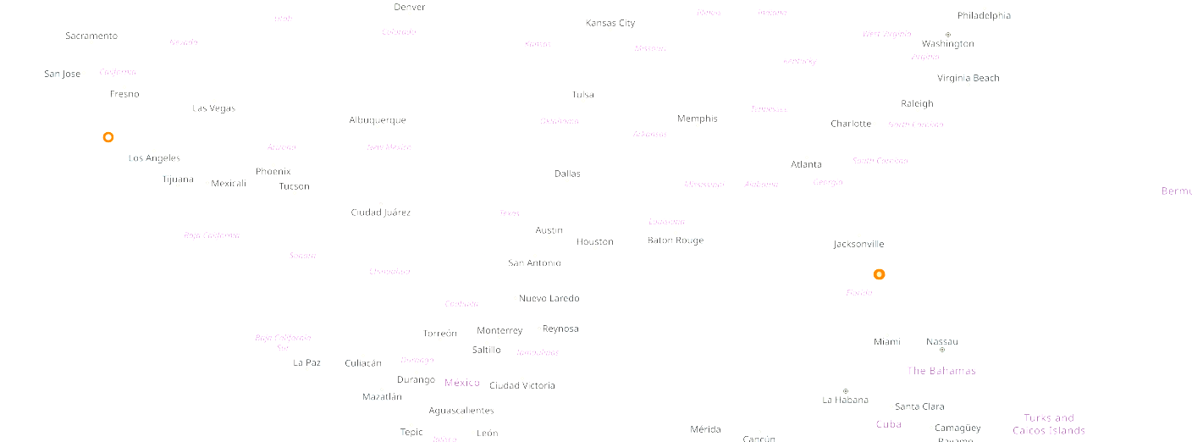
Mark all launch sites on a map

Slide 36
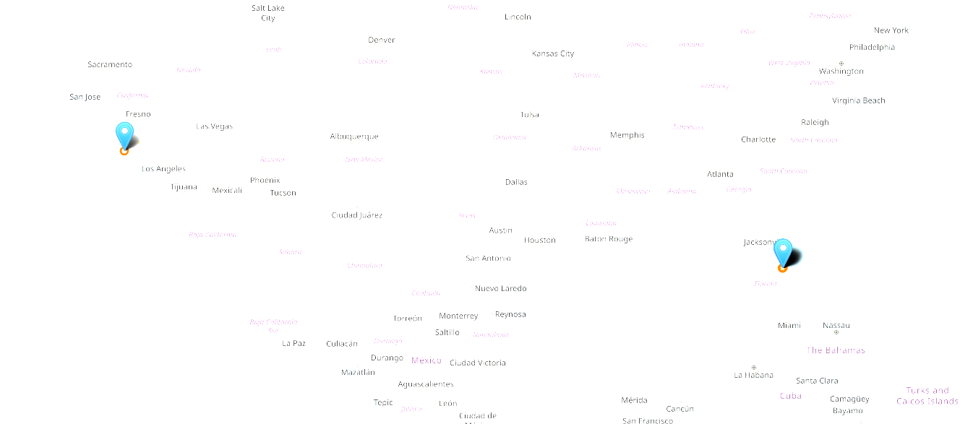
Mark the success/failed launches for each site on the map

Slide 37
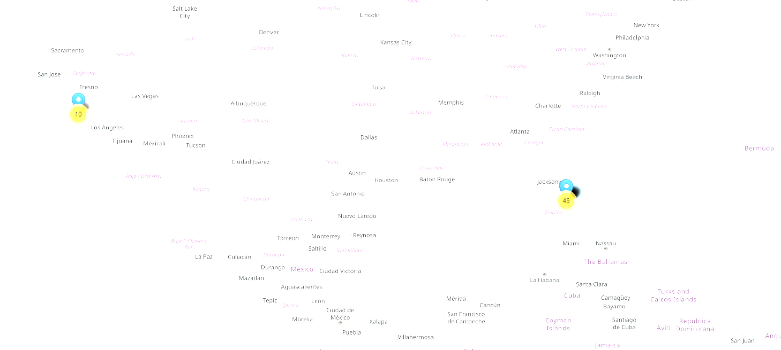
Calculate the distances between a launch site to its proximities

Slide 38

Section 4

Slide 39
Launch success count for all sites
Replace <Dashboard screenshot 1> title with an appropriate title
Show the screenshot of launch success count for all sites, in a piechart
Explain the important elements and findings on the screenshot

Slide 40
Launch site with highest launch success ratio
Replace <Dashboard screenshot 2> title with an appropriate title
Show the screenshot of the piechart for the launch site with highest launch success ratio
Explain the important elements and findings on the screenshot

Slide 41
Payload vs. Launch Outcome
Replace <Dashboard screenshot 3> title with an appropriate title
Show screenshots of Payload vs. Launch Outcome scatter plot for all sites, with different payload selected in the range slider
Explain the important elements and findings on the screenshot, such as which payload range or booster version have the largest success rate, etc.

Slide 42

Section 5

Slide 43
Classification Accuracy
Logistic Regression Accuracy:
Support Vector Machine Accuracy:
Decision Tree Classifier Accuray:

Slide 44
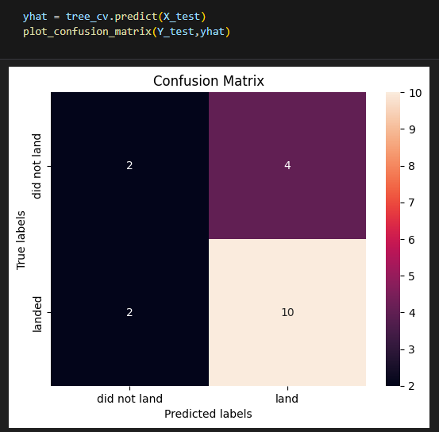
Confusion Matrix
The Decision Tree Classifier is the
classifier with the best accuracy

Slide 45
Conclusions
The project could be finished successfully
Several Machine Learning Techniques could be used
The tasks were closed with success

Slide 46
Appendix

Slide 47


